Slide 1
Project – 03 Inventory Matching Compliance
Luis E. Cardenas

Slide 2
background
Dangerous Goods (DG) are regularly used in the resources industry. Some of these materials (including explosives and radioactive components) may harm the environment or society if mishandled.
This project aims to grant visibility of relevant variables that provide a status of DG inventory – Paramount for the health and safety of personnel and maintaining a license to operate.

Slide 3
PROBLEM
The maintenance of the asset database and compliance adherence is spread out among different segments.
internal information
The data gathered from multiple sources (a mixture of .pdf, .csv and others) depending on the data source
Data integration
Visualize:
Non-conformances
Type of non-conformance
Location of non-conformance
Current situation
Understand the current location and compliance status behaviour.
With a clear picture of the status formulate a way forward.
Priority action plan

Slide 4
Proposed solution
internal information
Gather information from different company segments, allowing for a straightforward evaluation of the complete inventory status
DATA integration
Perform the ETL process to be able to consolidate and visualise relevant data
Current situation
Understand the compliance status and create three visual aids to facilitate the evaluation of the current situation
Priority action plan
Based on the visualisation of the data, start an action plan to reduce the non-conformance events locally.

Slide 5
Project OVERVIEW

Slide 6
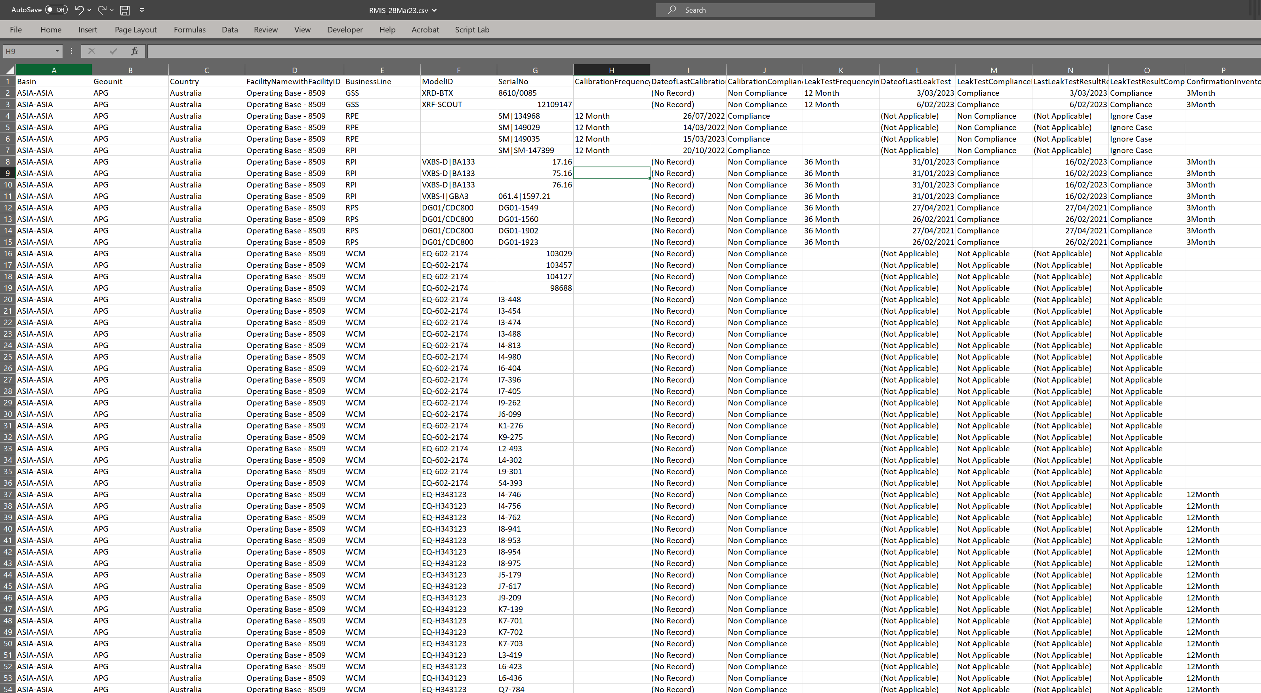
Gathering data
Notes:
Sources of information included maintenance equipment records, local registers among others. The data came in different formats.
Different sources of information were diverse: Local State registers and Maintenance information. The data depicts different services business lines and includes information from the Asia region. Countries include 'China', 'Indonesia', 'Australia', 'Japan', 'New Zealand', 'Papua New Guinea', 'Taiwan, Province Of China'

Slide 7
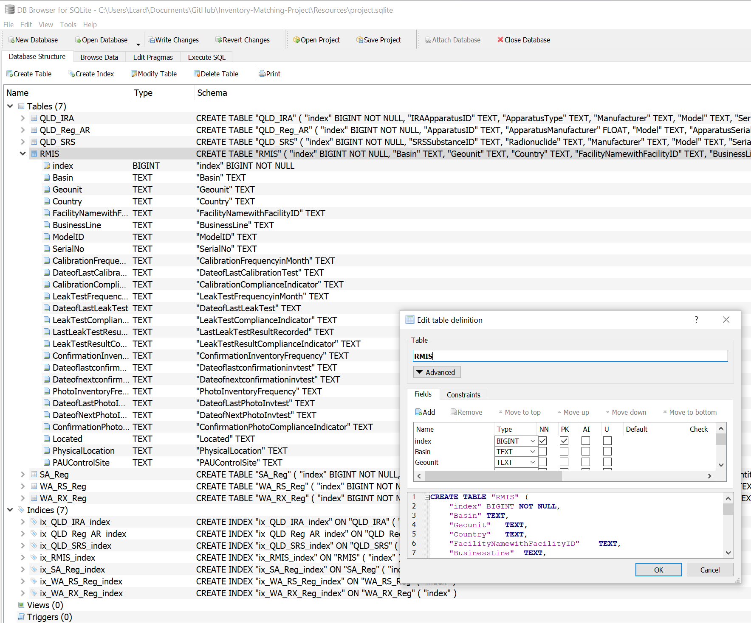
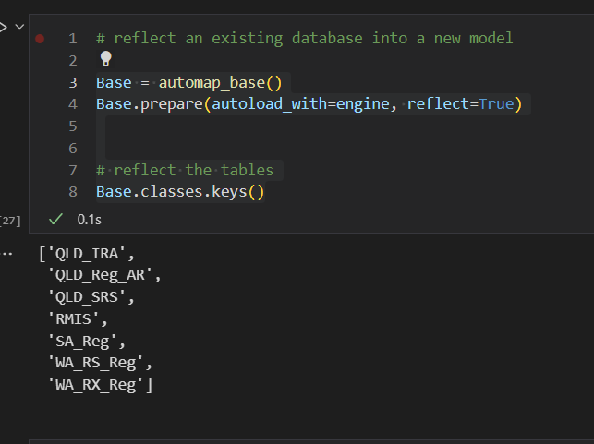
Creation of SQL Lite database
Primary Keys and Not Null required!!!
Notes:
Different sources of information were diverse: Local State registers and Maintenance information. The data depicts different services business lines and includes information from the Asia region. Countries include 'China', 'Indonesia', 'Australia', 'Japan', 'New Zealand', 'Papua New Guinea', 'Taiwan, Province Of China’.
Data was dealt with and loaded to a SQLite db. Issues around PK were evident

Slide 8
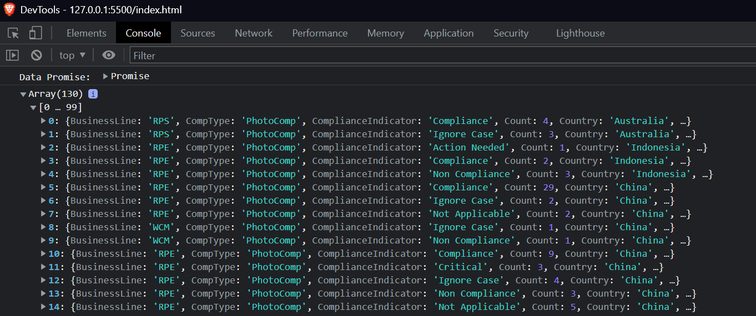
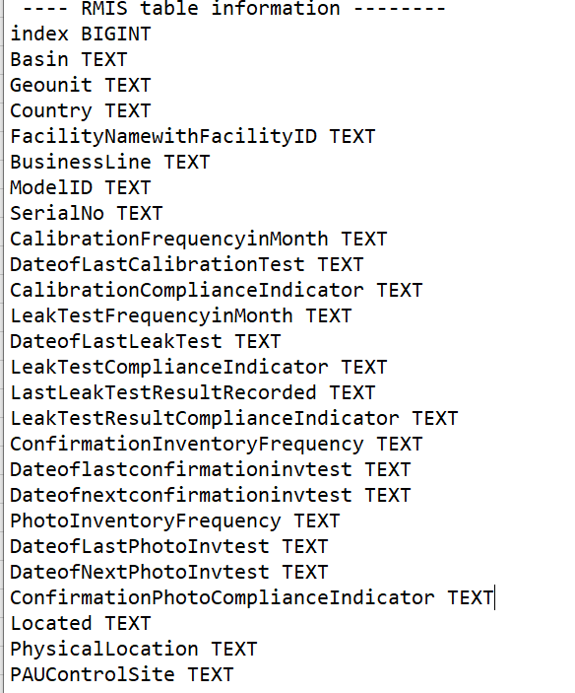
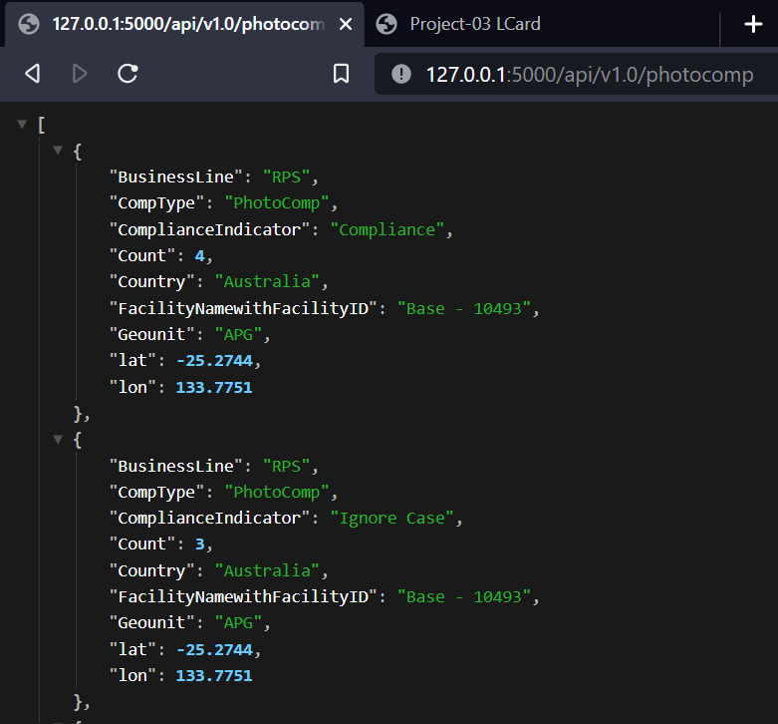
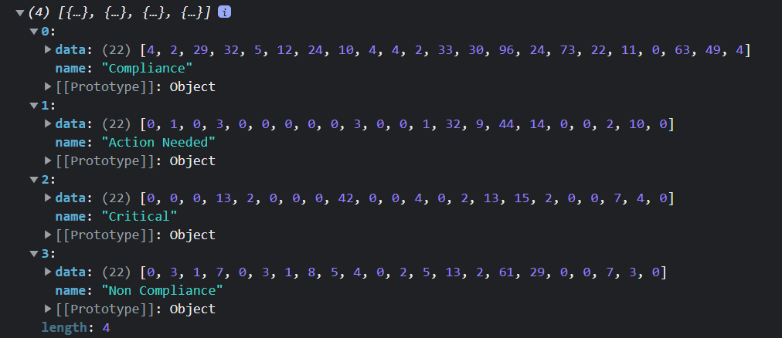
Gathering data
Personnel Safety and Equipment Control
Photo Confirmation
Leak Test
Measuring Equipment Calibration
Notes:
The variables that were selected to understand the behaviour where the R/A Measuement equipment Calibration Records, R/A Source Leak Test Records and Photo inventories. The data was queried from the SQLite database and sent via JSON through an Flask API. JavaScript was then used to handle the data to match the requirements of the libraries used for visualization.
For the project Highcharts JS and Leaflet Libraries were used for the visualizations.

Slide 9
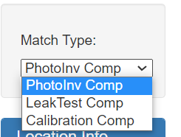
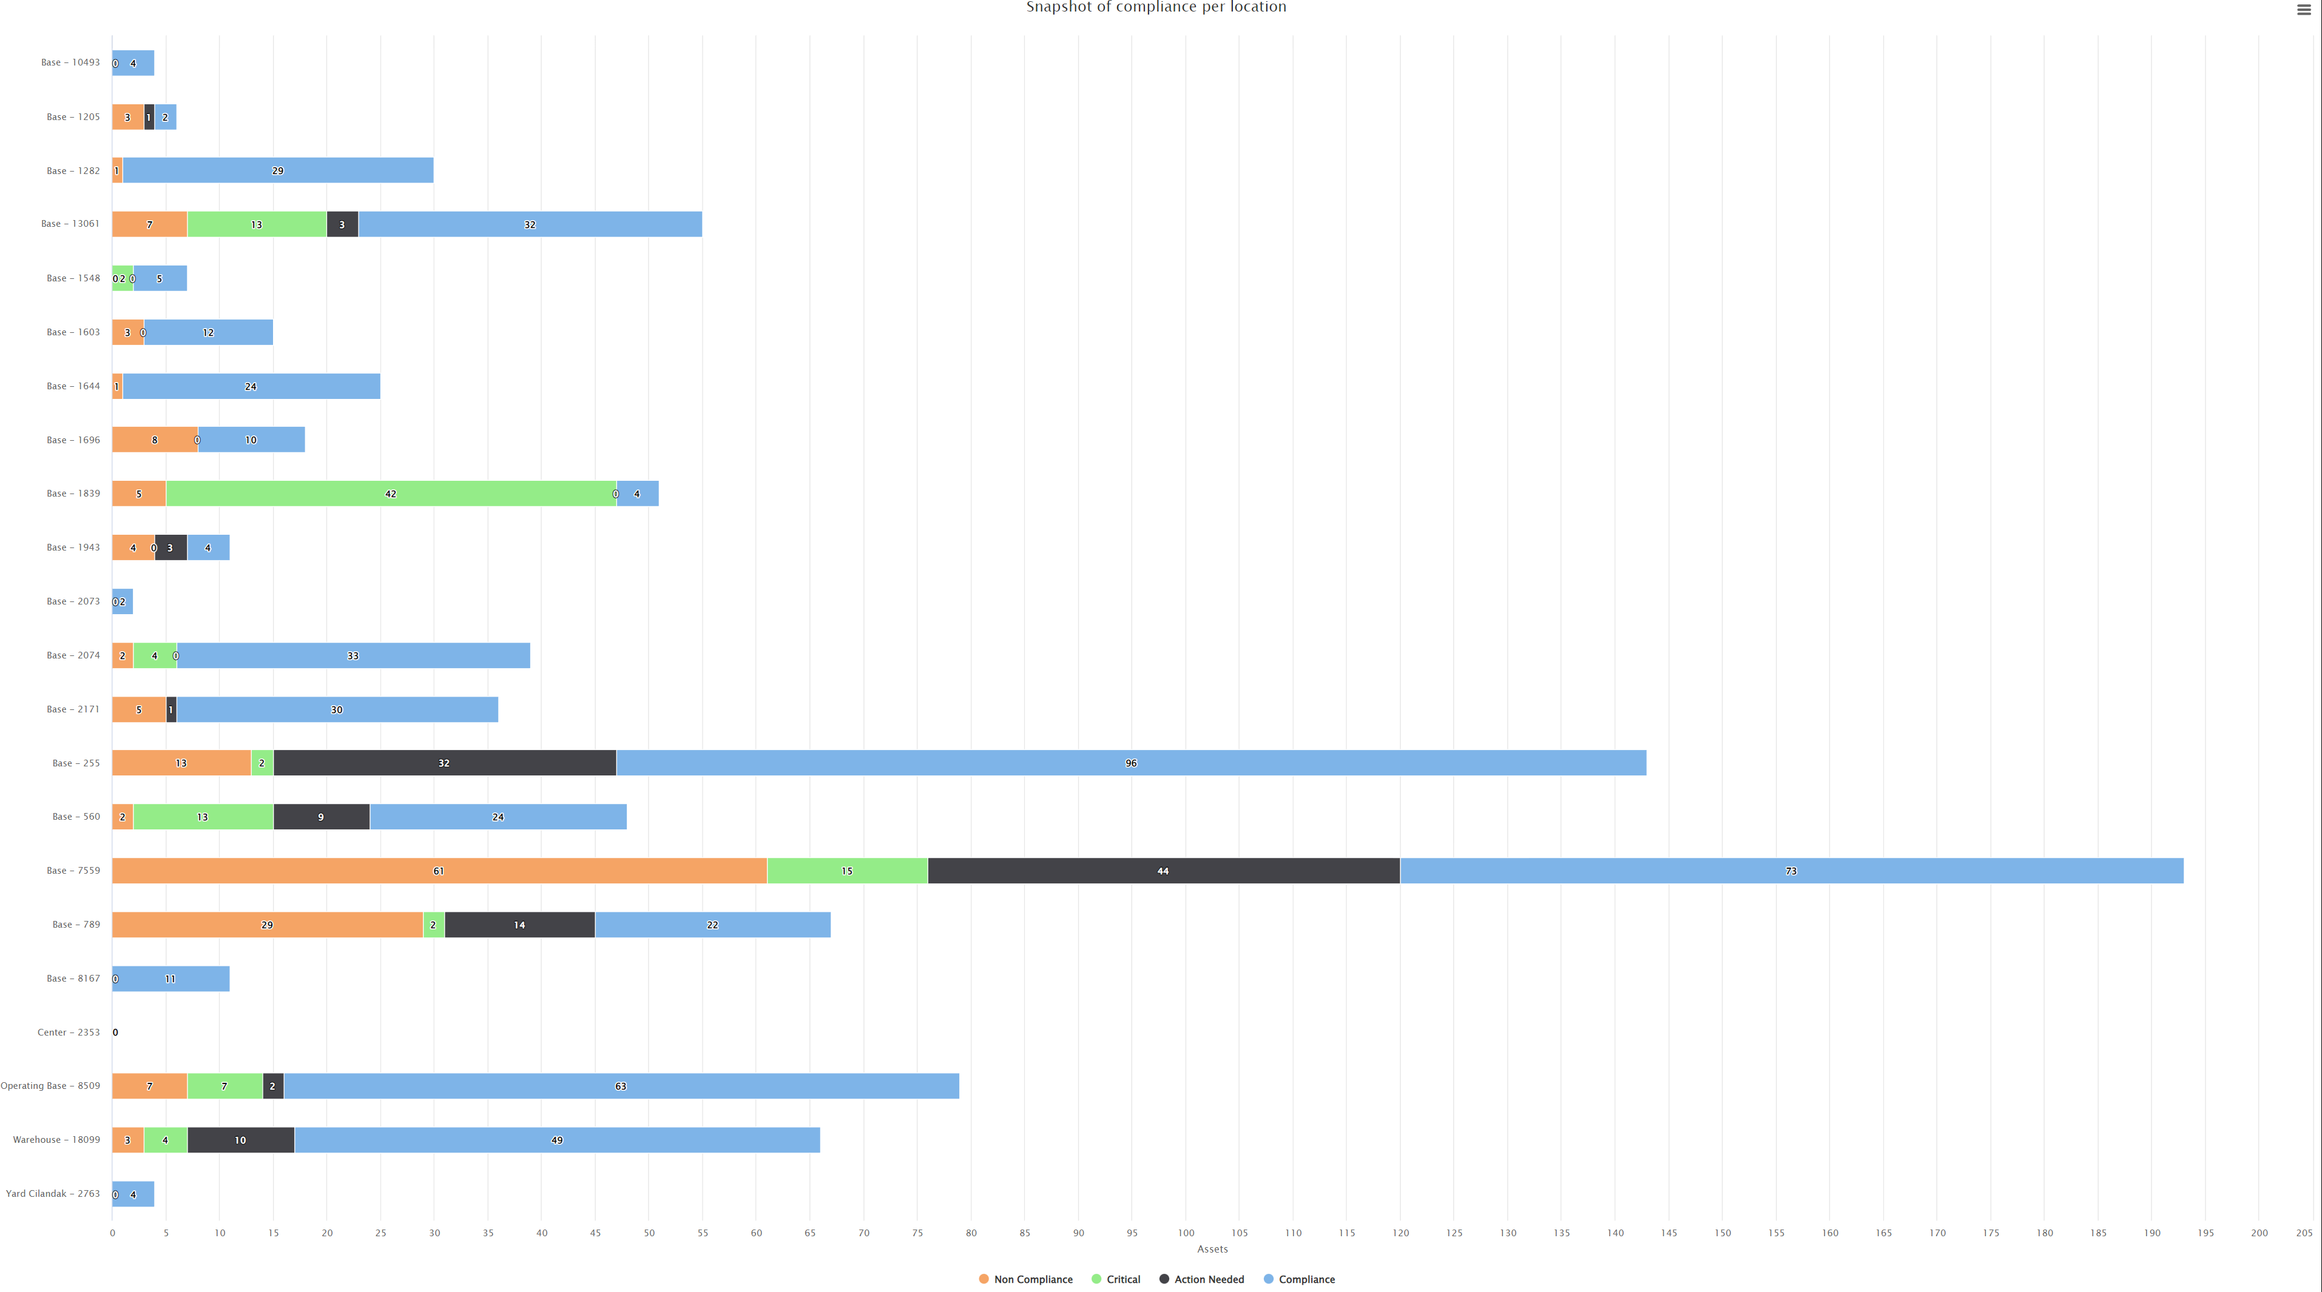
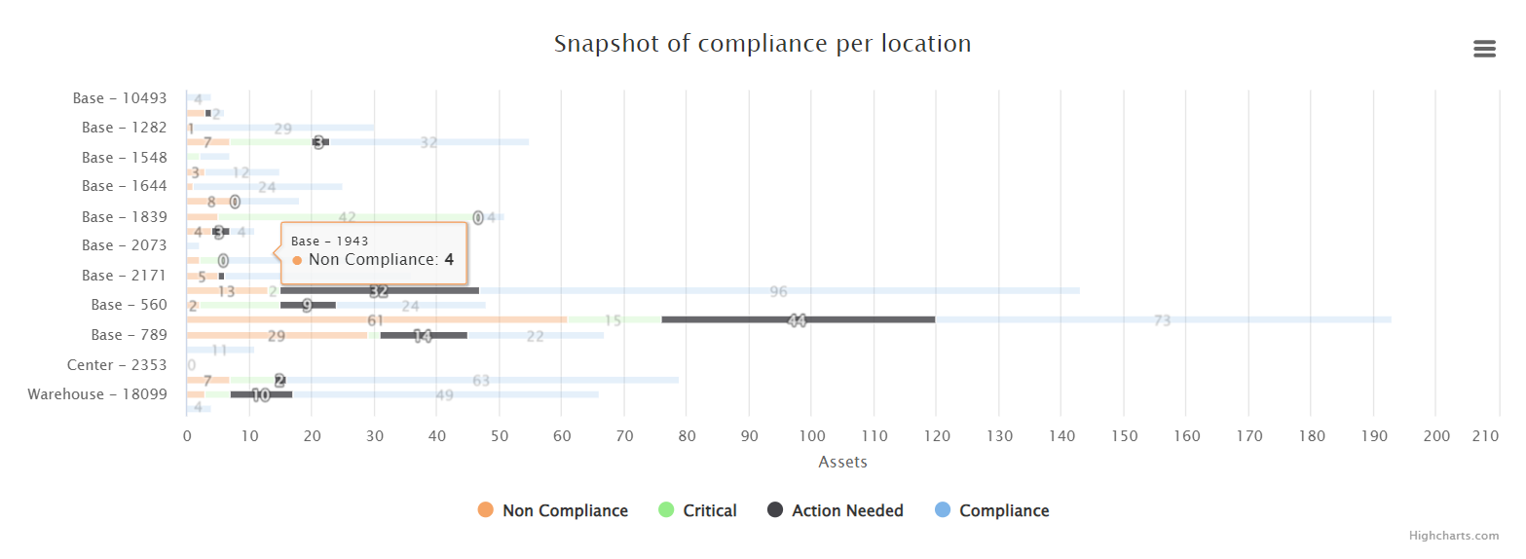
Data visualisation
Compliance status
Measured variables per Location
Compliance
Action Needed (Compliant)
Critical (Compliant)
Non-Compliance
Notes:
For the 3 types compliance, equipment was registered as Compliant, Action needed (where the time to expire is within a month), Critical ( within a week) or Non compliant. One of the visualizations plotted the compliance by location.

Slide 10
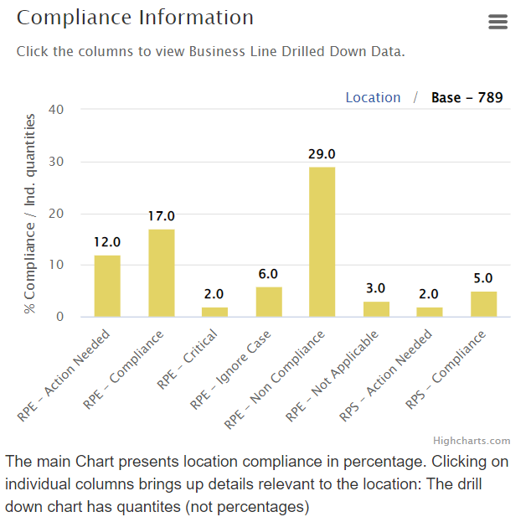
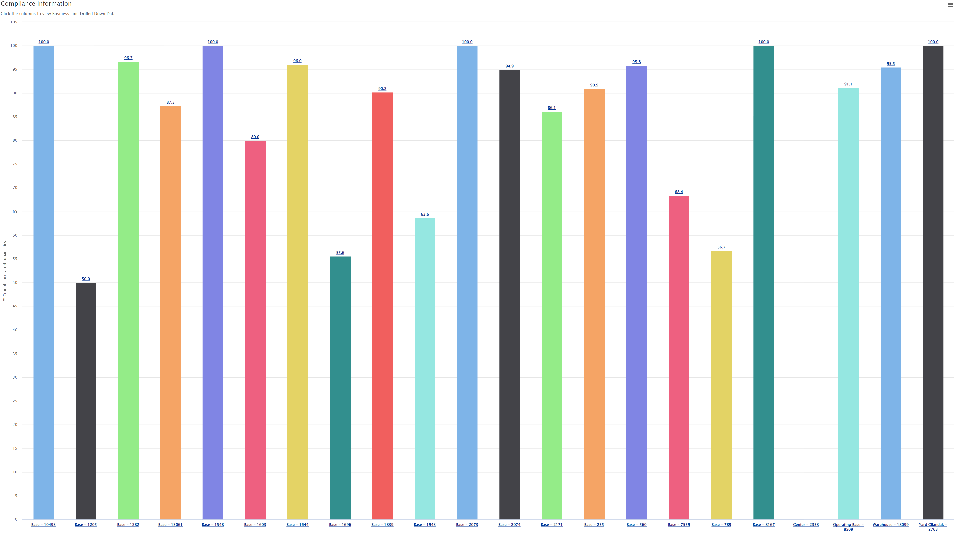
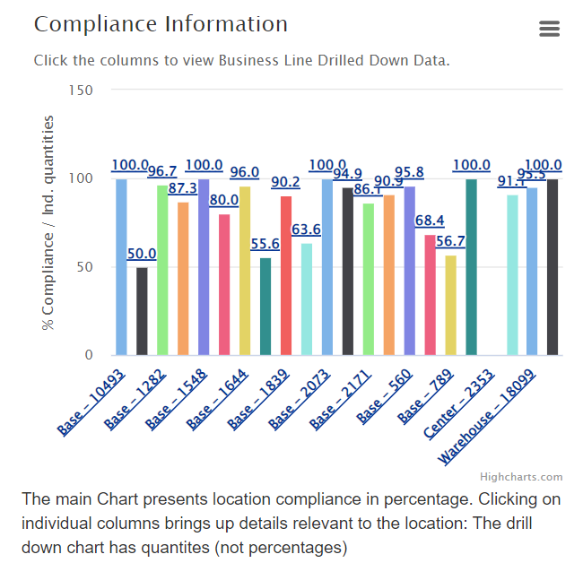
Data visualization
Asset status by division –drill down on location
Measured variables per Location / Segment
Compliance
Action Needed (Compliant)
Critical (Compliant)
Non-Compliance
Notes:
In one location, more than one product line can be present. For this reason a drill down visualization was added to check to see whether there were differences between product lines. This chart also presents the data for the 3 types of compliance.

Slide 11
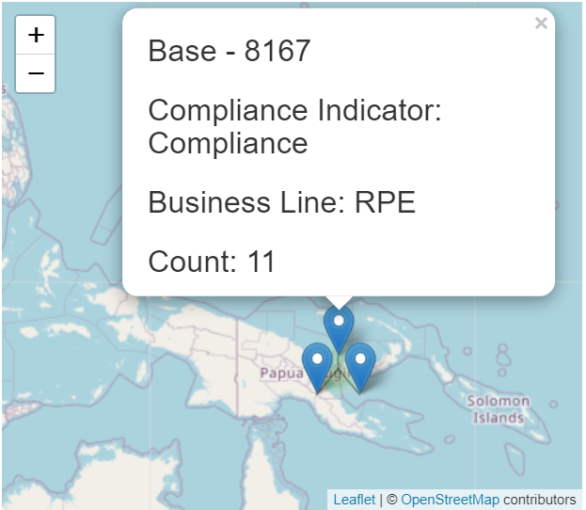
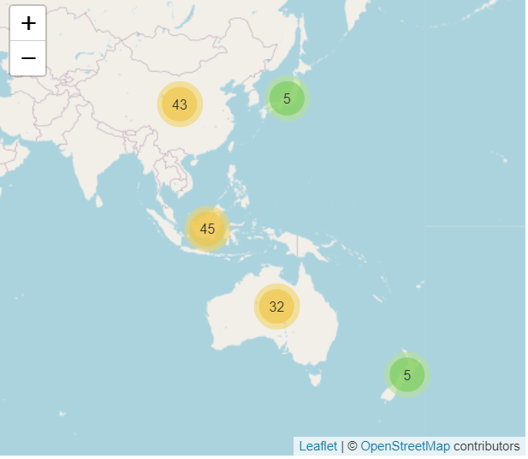
Data visualiSation
Visualization by country – asset status on map
Summary per Geography
Compliance
Action Needed (Compliant)
Critical (Compliant)
Non-Compliance
Notes:
Point clustering was used to visualize the data geographically. Each point presents the relevant summary

Slide 12
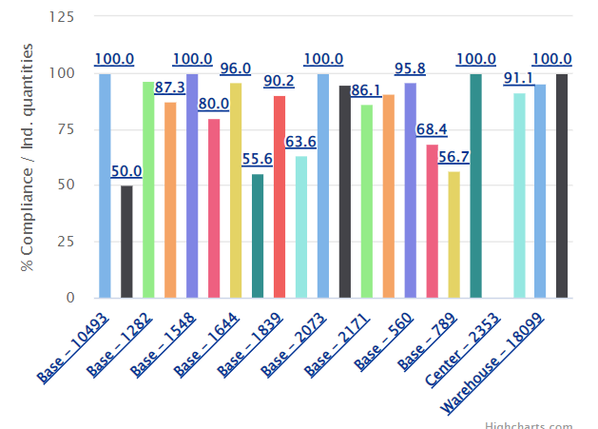
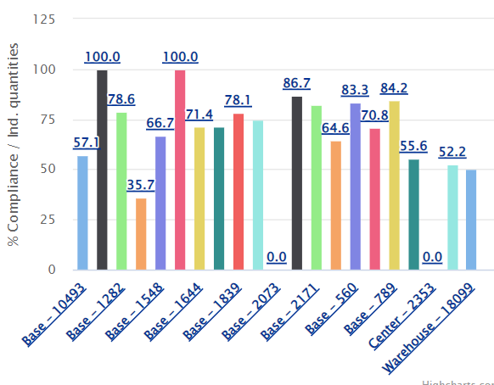
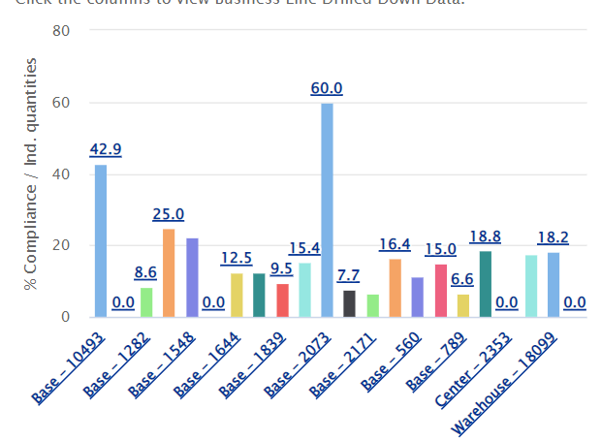
Results analysis
High compliance on Photo Inventories with more than 80% compliance in the whole Asia region
Leak test compliance is around 70% for the Asia region
Calibration equipment compliance is low, around 15% for the whole region
Notes:
Visually the Photo compliance is higher followed by Leak test. Calibrationequipment had the least compliance
Calbration Critical / Action Needed 18 Non Comp1080 total 1098
Leak tests Criticla / Action Needd18 26 Non Comp216 total 242
Photo Criticla / Action Needd 223 Non compl 154 total 377

Slide 13
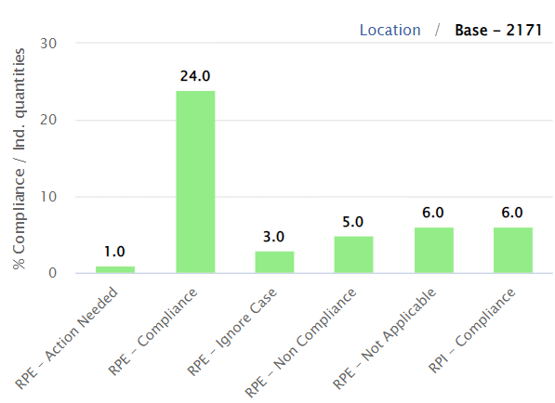
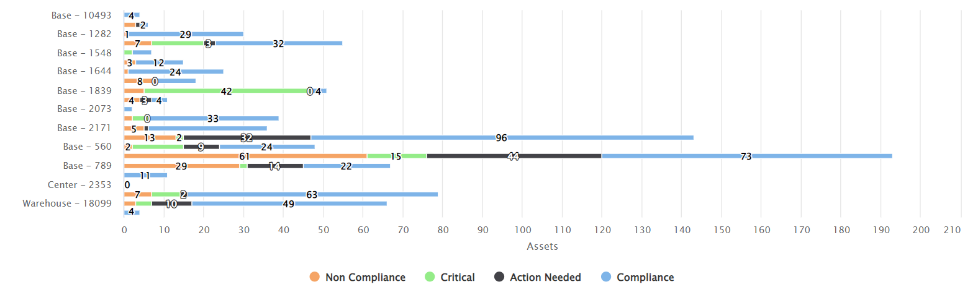
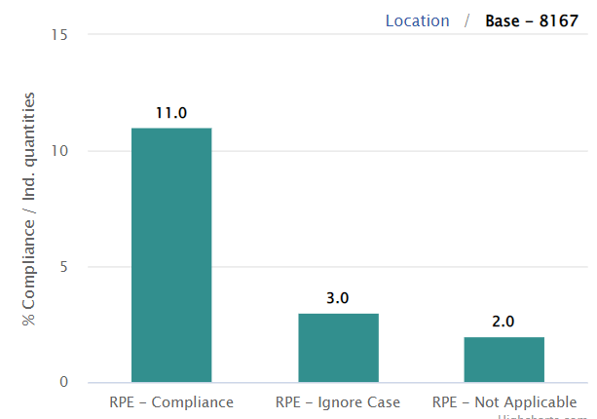
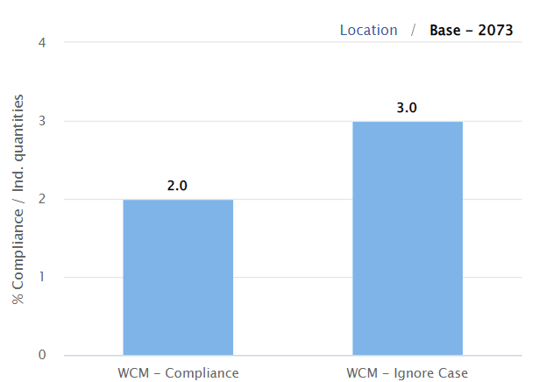
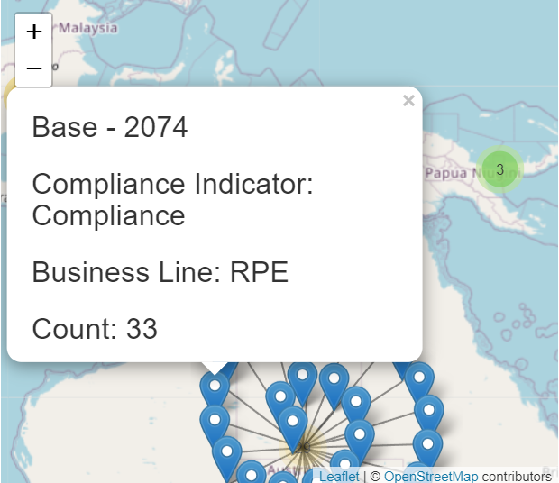
Results analysis
Segments with less equipment tend to have higher compliance scores
In Australia Photo inventory compliance is high - above 90%, Leak Test Compliance
around 70%, and calibration equipment compliance is around 15% following the
trends of the region
Notes:
Calbration Criticla / Action Needd18 Non Comp1080 total 1098
Leak tests Criticla / Action Needd18 26 Non Comp216 total 242
Photo Criticla / Action Needd 223 Non compl 154 total 377

Slide 14
SUMMARY
A clear, concise and unified visualisation of data allows an understanding of the current situation.
The control of the material is being maintained by diligent Photo inventory keeping.
Leak Tests are being performed on the equipment. This metric could improve to match the Photo Inventory levels.
Different locations in the Asia region behave similarly.
A better job overall needs to be done with the Calibration records keeping of the equipment. Support and training in this respect might help increase the compliance metrics.
Interactive charts facilitate the global view of a current snapshot, regardless of the segment or location.

Slide 15
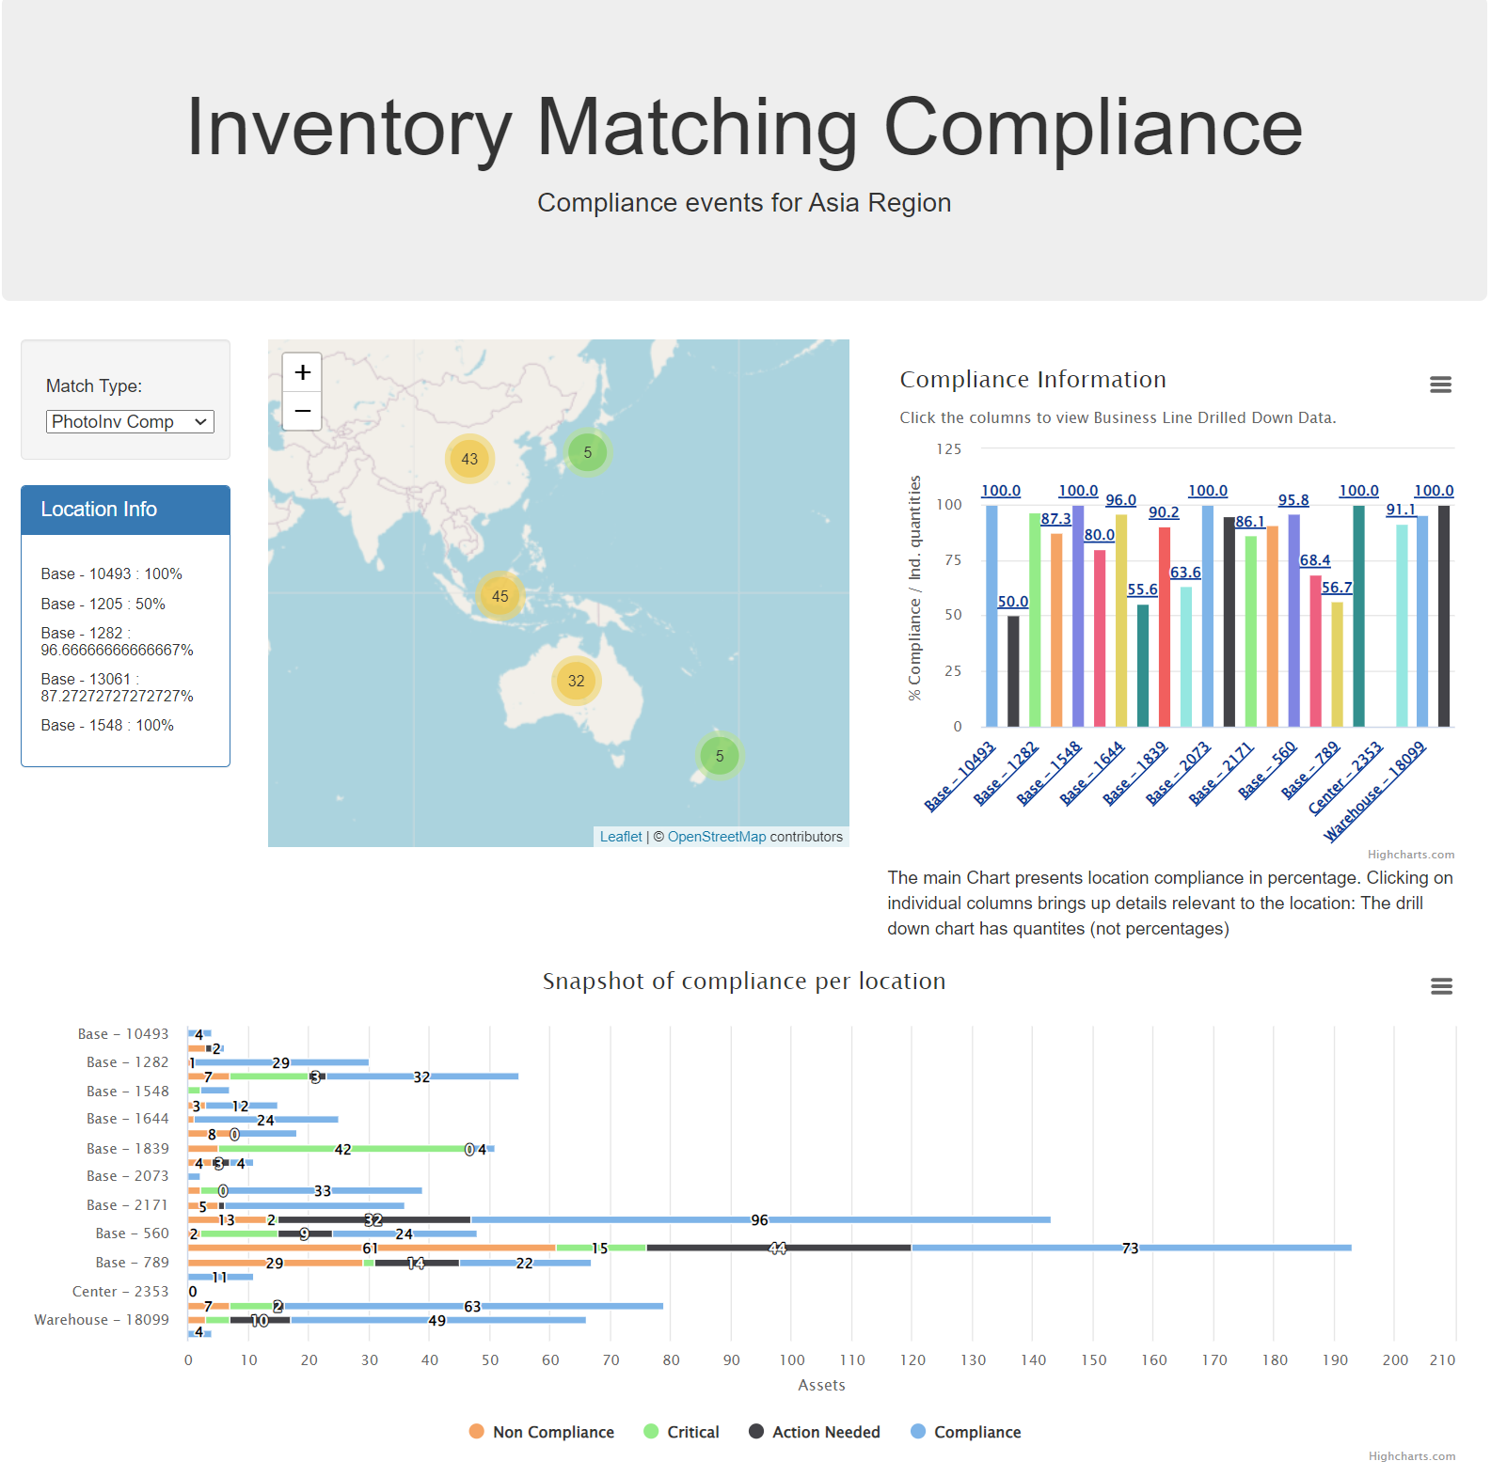

Project requirements
Based on Project Requirements
Key objective* Metrics
 | Data and Delivery | Back End | Visualisation
Documentation of Data Components
SQLite Database
1200+ Assets
Flask API, HTML/CSS, JS, SQLite
Page Project – 03
HighCharts JS
Dashboard
3 Views
User Driven interactions
* Other metrics are subjective – Digestible, easy to interpret, and presentation aspects

Slide 16
THANK YOU
Luis E. Cardenas​
lcardsvr@gmail.com
https://github.com/lcardsvr

